Slide 1
Chapter 14
Europe and the World: New Encounters (1500-1800)

Slide 2
Why did Europeans begin to embark on voyages of discovery and expansion?
Fantasy
Thanks to the printing press people read stories like The Travels of John Mandeville that described fantastic other lands. People were curious about what was out there
Economic Motives
The Ottomans’ control of Asia Minor cut off trade with the Far East; Explorers looked for other routes
Marco Polo wrote Travels about what could be found in the East
Christopher Columbus carried it with him to the New World

Slide 3
Why did Europeans begin to embark on voyages of discovery and expansion?
Religion
The Reformation and Counter Reformation inspired people to spread their personal religions
Personal Glory
Humanism at its finest!
Technological Innovation…
Summed up with: God, Glory, Gold

Slide 4
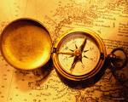
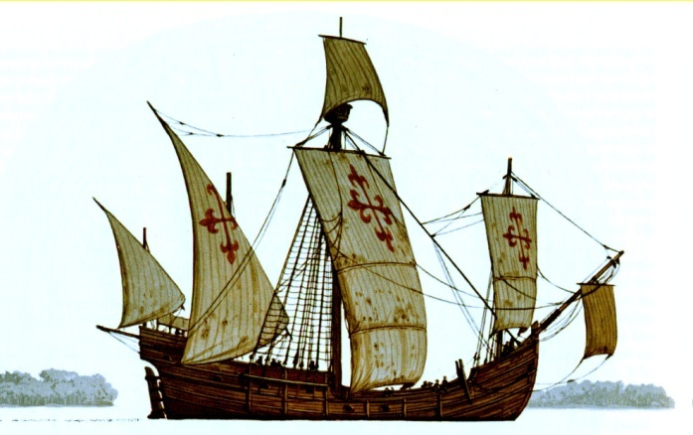
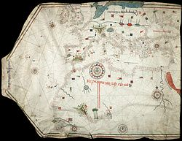
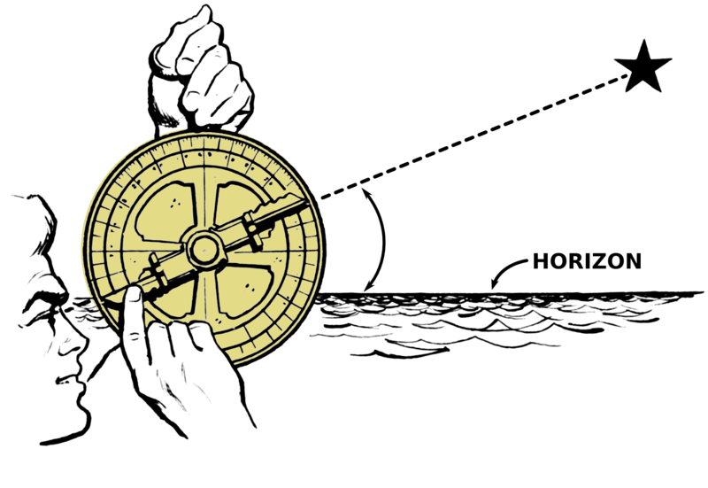
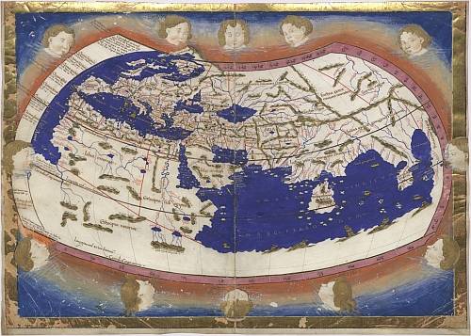
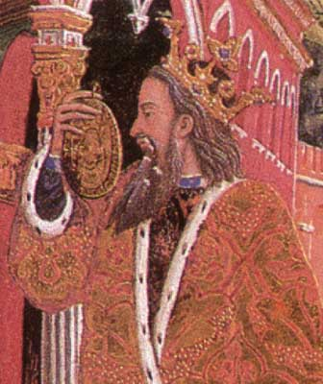
New Technologies
Maps
Portolani- charts made by medieval navigators and mathematicians useful for navigation
Coastal contours, distances between ports, compass readings
Geography, by Ptolemy, was translated into latin
Showed the earth to be spherical with three major landmasses and two oceans
Underestimated circumference of the earth
Ships
Axial rudder, lateen sails made faster ships that could sail against the wind
Compass
Astrolabe
Wind Patterns

Slide 5
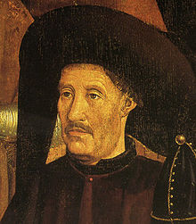
How did Spanish and Portuguese acquire their overseas empires?
Prince Henry the Navigator (1394-1460)
Founded a school for navigators in 1419
Gradually explored the African coast
Exported slaves, gold, ivory

Slide 6
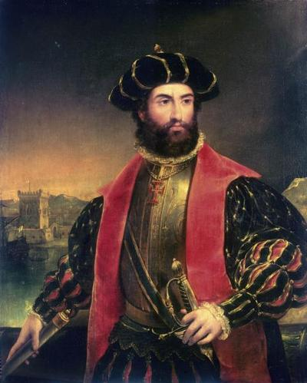
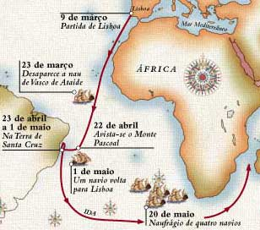
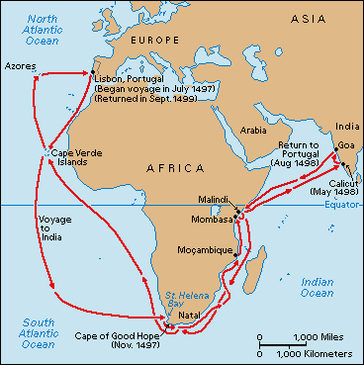
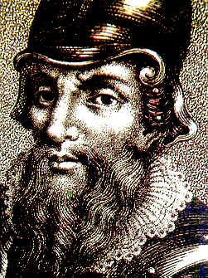
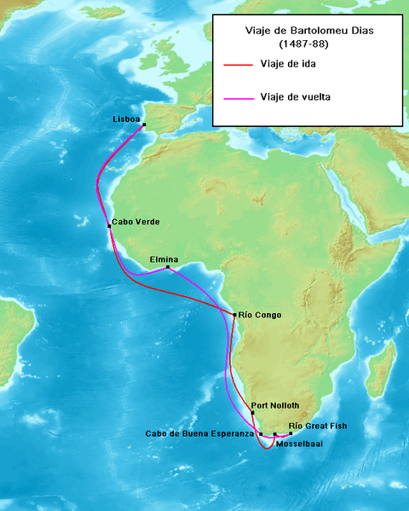
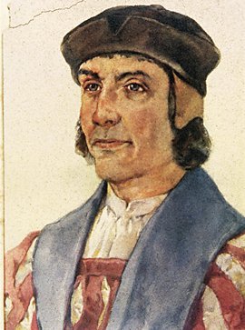
PORTUGUESE EXPLORERS
Bartholomeu Dias (1450-1500)
1488: Used westerly winds to make it round the Cape of Good Hope
Vasco de Gama
1498: rounded the Cape, made it to India
Pedro Cabral
Sailed west to avoid windless Gulf of Guinea
Discovered Brazil

Slide 7
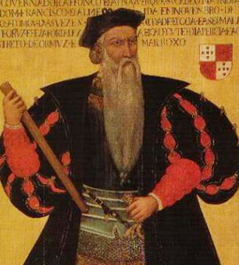
How did Spanish and Portuguese acquire their overseas empires?
Afonos de Albuquerque (1462-1515)
Set up port facilities at Goa, western coast of India
Headquarters for Portuguese operations
Massacred city of Malacca to control spice trade
Guns and skill at sea ensured success in the east

Slide 8
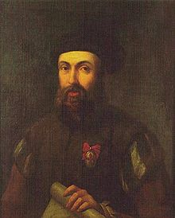
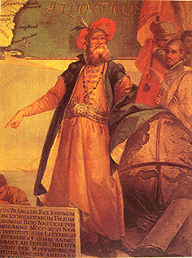
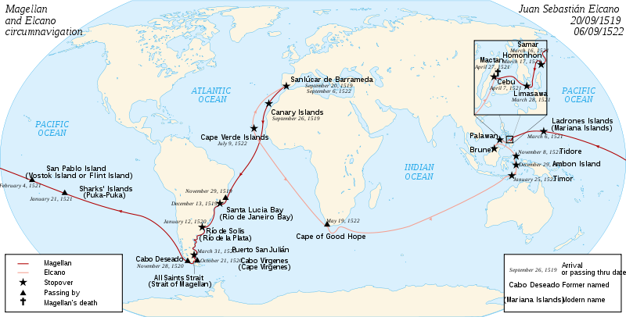
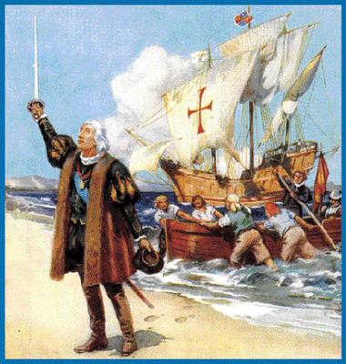
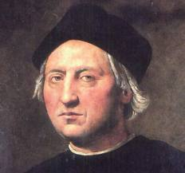
New World Explorers
Christobal Colon, (Christopher Columbus)(1451-1506)
Explorer from Genoa, Italy
Convinced the circumference smaller than people said
Ferdinand and Isabella of Spain financed trip
Made 4 voyages to Americas, never knowing it wasn’t India
Giovanni Caboto (John Cabot)
Venetian, Sailed for Henry VIII
New Foundland
Amerigo Vespucci discovered that the Americas weren’t Asia
1513: Vasco Nunez de Balboa led expeditions to the Isthmus of Panama
“Discovered” the Pacific
1519: Ferdinand Magellan sailed west to explore the Pacific
Killed in the Philippines, His men first to circumnavigate the world
Only 18 survived journey

Slide 9
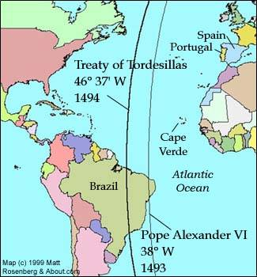
Spanish & Portuguese
Referred to the Western Hemisphere as the “New World”
Treaty of Tordesillas (1494)
Divided New World between Portugal and Spain

Slide 10
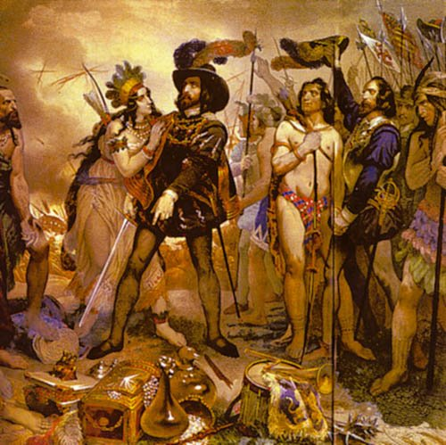
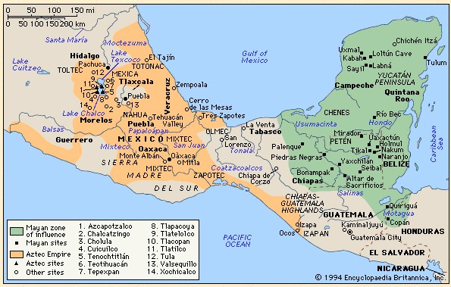
The New World
Conquistadors- mercenary soldiers that conquered the new world for Spain
Maya in Mesoamerica on Yucatan Peninsula
Temples, pyramids, and THE calendar
Aztecs in central Mexico
Tenochtitlan (no Mexco City
Warriors
Hernan Cortes (1485-1547)
1519- landed at Veracruz
With help of the Maya marched to Tenochtitlan
Met Moctezuma (believed he was Quetzalcoatl)
Brought smallpox and destruction

Slide 11
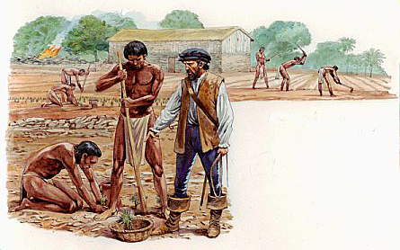
The New World
Spain in the Caribbean
Encomienda: colonist was given land and Native Americans to work the land – in exchange they would preach Christianity
Disastrous for Natives: mistreatment,
Diseases: spread by Europeans (Smallpox, tuberculosis, measles)

Slide 12
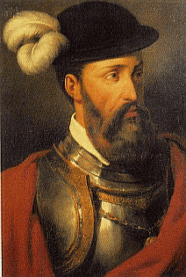
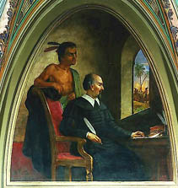
The New World
Francisco Pizarro
Conquistador, led an expedition to Peru
Peru had fabulous wealth
Took advantage of civil war destroyed the Inca
Bartolome de Las Casas: tried to protect natives from slave labor by bringing Africans for slavery

Slide 13
Politics in the New World
VICEROY: king chose officials who ruled large areas in King’s name
Aided by audiencias- supreme judicial bodies
Peninsular System: Strict Class System
Peninsulares- Spanish born (from the Iberian Peninsula)
Creoles- European descent, American born
Mestizos- Spanish and Native
Mulattos–Spanish and African
Natives
Zambos- Native and African
African

Slide 14
How did the arrival of the Dutch, British, and French on world scene affect Africa?
Dutch East India Company (1602)
Settlements at Cape of Good Hope
Boers: Dutch farmers
Discovery of Americas in 1490s and development of sugar cane changed the Slave Trade
African slaves easier to control
Less susceptible to disease
Triangular Trade: connected Europe, Africa, Americas

Slide 15
RAW MATERIALS
(SUGAR, LUMBER, TOBACCO)
MANUFACTURED
GOODS
(IRON, RUM)
SLAVES

Slide 16
Triangular Trade
Raw Materials to Europe
Raw cotton, sugar, timber
Other stuff too: Tobacco, molasses, rum, coffee,
Manufactured Goods to Africa
Guns, gin, cloth
Slaves from Africa to New World
10,000,000 slaves exported between 16th-19th centuries

Slide 17
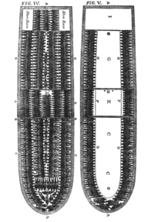
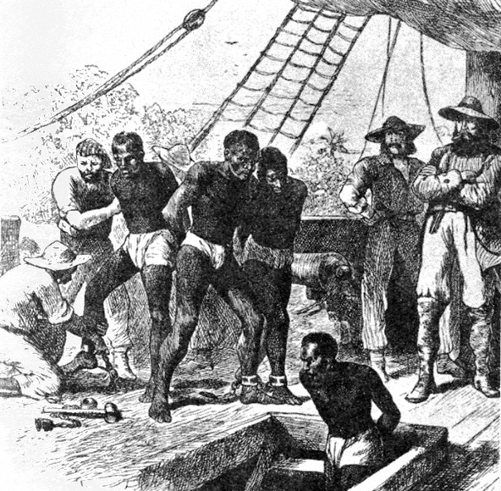
Middle Passage: slaves to America
3-6 weeks
300-450/ship
10-20% died
AFRICAN DIASPORA: SPREAD OF AFRICAN CULTURE

Slide 18
Columbian Exchange: Widespread exchange of plants, animals, and disease
From the New World
From the Old World
Guinea Pigs
Llamas
Turkeys
Avocados
Beans
Cashews
Chilis
Chocolate
Corn
Peanuts
Potatoes
Rubber
Strawberries
Tobacco
Tomatoes
Vanilla
Cattle
Chickens
Donkeys
Goats
Horses
Cats
Mice & Rats
Pigs
Rabbits
Sheep
Bananas
Black Pepper
Citrus
Garlic
Onions
Lettuce
Peaches
Sugar
Wheat
Rye, Oats
Syphilis?
Cholera, Influenza, Malaria, Measles, Smallpox

Slide 19
Columbian Exchange

Slide 20
How did the arrival of the Dutch, British, and French on world scene affect Asia?
After Magellan’s arrival, Spain was able to gain control over the Philippines
Silk and luxury goods carried to Mexico in return for silver
Although an early arrival, Portugal had trouble dominating trade because it was too small of a kingdom – it lost control to the:

Slide 21
Southeast Asia
Dutch controlled much of Indian Ocean
Sri Lanka
Drove English out
Pepper plantations on Java and Sumatra
West Indies desired for sugar plantations
Mainland SE Asia resisted Europeans
Myanmar, Thailand, Vietnam
Were more cohesive politically with strong monarchies
Able to fund, combat, and withstand attacks

Slide 22
India
17th Century England settled trading posts in Surat, Calcutta, and Madras
Took Indian cotton to East Indies to trade for spices
East India Company- joint-stock company funded trips
Sir Robert Clive- aggressive empire builder
Defeated Mughal armies in Battle of Plassey
Seven Years War – British forced rival French out of India

Slide 23
China
Tea and silk traded to England
China tried to limit European access and only allowed trade outside city of Canton from October – March
British demanded more access to Chinese cities
1793: Lord Macartney traveled to Beijing to have trade restrictions lessened
Called China“an old, crazy, first-rate-man-of-war” that would be “dashed to pieces on the shore”

Slide 24
Japan
Portuguese arrived in 1543
Jesuits arrived in 1549
Europeans expelled
Dutch allowed to visit port at Nagasaki once a year because they had not tried to convert

Slide 25
Exploration DBQ
Explore each document
Answer accompanying questions
Questions due Next Class
Thesis and outline due Class after Next

Slide 26
Economic Conditions in 16th Century
Price revolution- inflation in 16th and 17th century
Wheat prices rose in the Mediterranean in 1590s
Wages failed to keep up with inflation
Standard of living dropped
Landed aristocrats, who collected rent, prospered
ked for new ways to invest money
Causes:
Influx of gold and silver?
Increase in population led to increased demand, driving prices up

Slide 27
Economic Conditions in 16th Century
Flourishing trade surrounded
Mediterranean
Low Countries
Central Europe on the Rhine and Danube
Joint stock companies- individuals bought shares in a company and received dividends
Board of directors ran company and made decisions
Dutch East India Company investors received 30% profit in first 10 years

Slide 28
Economic Conditions in 16th Century
Bank of Amsterdam, 1609, deposit and transfer institution
Amsterdam Bourse (exchange) traded stocks instead of goods
Hub of European business world
Note: Although trade between old and new world flourished, trade within Europe was still greater

Slide 29
MERCANTALISM
$
A nation’s strength depends on its wealth
Fixed amount of wealth & trade in world
Two sources of wealth:
Mining Gold & Silver
BALANCE OF TRADE: sell more than you buy
Reduce imported goods with Tariffs
Encourage high prices for exports
Encourage new industries (SUBSIDIES)
Control overseas sources of raw materials
No need to import
No spending money for goods
No fear of rivals cutting supplies

Slide 30
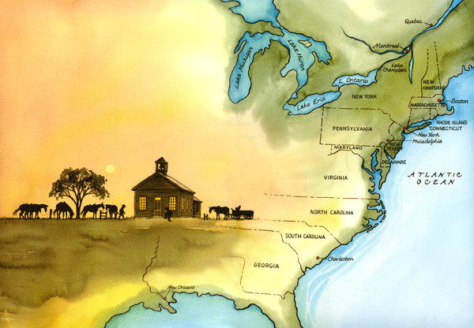
EFFECTS OF MERCANTALISM
COLONIES
Set up to control sources of raw materials and provide markets for manufactured goods
Empires controlled colonists ability to sell raw materials to other nations
Forbade manufacturing goods
New class of wealthy European Merchants emerge
Begins to wield power

Slide 31
North America
Although Spain claimed all of North America, most ignored their claims
Dutch set up settlements after Henry Hudson discovered his river in 1609
New Netherlands stretched from mouth to Albany
Staten Island and Harlem Dutch names
1664: English seized New Amsterdam, named it New York, Dutch West India Company went bankrupt

Slide 32
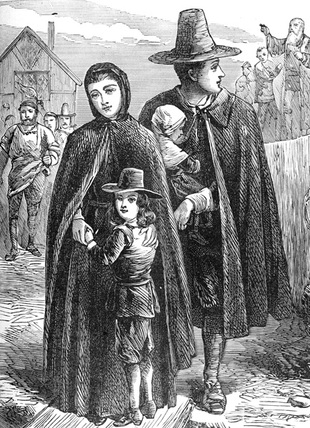
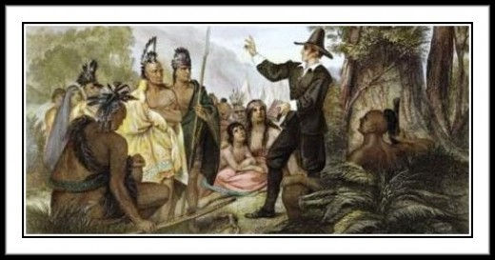
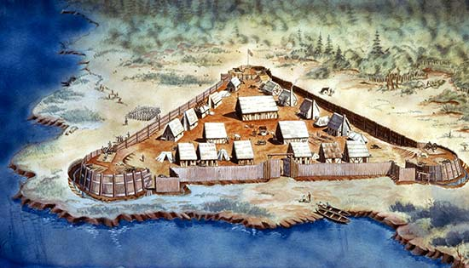
North America
Jamestown: 1607, first permanent English settlement
Looked for gold and route to the Pacific
Failed on both counts
Almost failed as a community due to the wealthy founders
Massachusetts Bay colony: 1660
Puritans seeking religious freedom
1.5 million people in 13 colonies by 1750

Slide 33
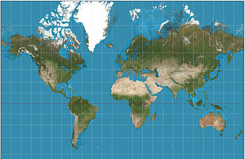
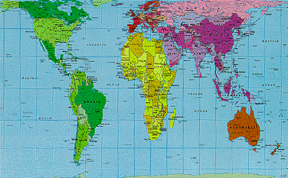
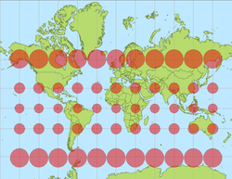
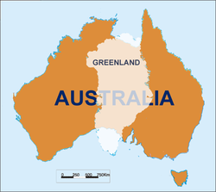
Impact of European Expansion
Native populations and cultures destroyed
Multiracial society was constructed in Americas
Millions of Africans brought West
Catholic Church dominated Latin America
Churches, hospitals, orphanages, schools, military bases
Controlled natives and ensured docility
European culture changed
Tea and coffee houses opened
Craze for Chinese furniture and porcelain
Increased rivalry, piracy
Mercator projection- world map attempting to show true shape of landmasses
Peters World Map Projection

Slide 34
Example
Price Revolution:
Inflation in Europe
Laborers make less money, landed aristocrats make more
Aristocrats look for new ways to invest money

Slide 35
Another Example
Price Revolution:
Inflation in Europe
Prices rise, laborers have lower SOL
Look for new opportunities
Look for new ways to invest
Aristocrats make more money from rent

Slide 36
PS-
Make sure to read the primary documents in this chapter!

